Slide 1

KYAMBOGO UNIVERSITY IMPLEMENTATION OF 5G NETWORK USING DYNAMIC SPECTRUM REFARMING Presented By TUSABE EVELYNE – 17/U/16426/ETE/PE KWOBA FREDRICK -18/U/10180/ETE/PE SUPERVISOR: MR SEMUJJU MARK

Slide 2
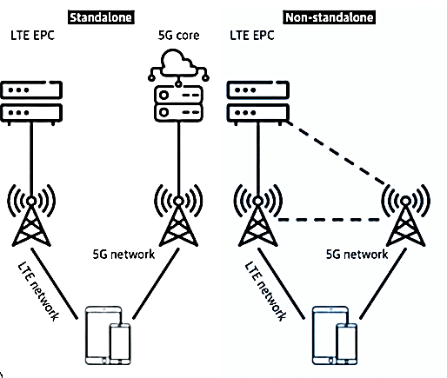
Introduction/ Background

Slide 3
Problem Statement
The radio frequency spectrum is a limited, scarce and expensive resource that can’t be extended. Moreover most of the existing spectrum resources are already allocated to various services and technologies such as 2G, 3G, and 4G.
Spectrum allocation is one the solution to ensure spectrum efficiency which means allocating 5G network frequencies of operation in the mm-wave and higher bands which is costly and expensive. In addition, these bands are highly affected by penetration losses and provide low coverage although they provide high capacity. Another solution is spectrum refarming which refers to a resource management technique that allows different network technologies to operate in the same frequency band.
This research provides a study on the concept of dynamic spectrum refarming as a method of tackling the problem of limited spectrum in particular between different networks (4G and 5G). It also provides the implementation of 5G network on non standalone architecture and evaluating the network performance in terms of throughput and latency

Slide 4
Objectives
Main Objective
To implement and assess the performance of 5G technology using dynamic spectrum refarming.
Specific Objectives
To investigate the performance of existing networks 4G.
To carry-out dynamic spectrum refarming of 5G
To evaluate the impact of dynamic spectrum refarming on throughput and signal latency of 5G.

Slide 5
Literature Review
The rapid evolution of wireless communication technologies has led to an increasing demand for spectrum resources to support the deployment of 5G networks. Dynamic spectrum refarming, the reallocation of spectrum from legacy networks to 5G, has emerged as a promising approach to meet this demand.
Dynamic spectrum refarming also necessitates international harmonization efforts and spectrum sharing mechanisms. Research by Lopez-Perez et al. (2019) and Yu et al. (2021) have discussed the importance of global spectrum harmonization to facilitate cross-border spectrum refarming and enable roaming services in 5G networks. Spectrum sharing approaches, such as dynamic spectrum access and spectrum sharing frameworks, are crucial to enable efficient and fair sharing of spectrum resources among multiple operators and technologies.
The impact of dynamic spectrum refarming on existing legacy networks is an important consideration. Studies by Song et al. (2019) and Gupta et al. (2022) have explored the effects of spectrum repurposing on the coverage, capacity, and user experience of legacy networks. Proper planning and coordination are necessary to minimize disruptions to existing services and ensure a smooth transition process during dynamic spectrum refarming.

Slide 6
Literature Review Cont’d
The coexistence of different generations of wireless technologies is a crucial consideration in dynamic spectrum refarming. Studies by Zhang et al. (2018) and Wang et al. (2021) emphasized the importance of interference management techniques and efficient spectrum sharing mechanisms to ensure smooth transition and coexistence between 5G and legacy networks. Proper planning and coordination are required to mitigate interference and ensure optimal performance in mixed-use spectrum environments.
The successful implementation of dynamic spectrum refarming relies on supportive regulatory frameworks and policies. Literature by Boccardi et al. (2018) and Gurung et al. (2023) highlighted the importance of harmonized spectrum management, licensing frameworks, and spectrum pricing models to facilitate spectrum refarming for 5G networks. Effective collaboration between regulatory bodies, operators, and other stakeholders is essential to ensure a fair and efficient spectrum allocation process.
Economic factors associated with dynamic spectrum refarming have also been explored in the literature. Research by Markendahl et al. (2020) and Wei et al. (2022) discussed the cost implications of spectrum refarming, including the investments required for network upgrades, device compatibility, and ecosystem development. Economic models and cost-benefit analyses have been proposed to assess the financial viability and potential return on investment for dynamic spectrum refarming strategies.

Slide 7
Justification
Dynamic spectrum allocation allows for efficient utilization of the available spectrum resources
Dynamic spectrum allocation enables the optimization of QoS parameters such as latency, throughput, and reliability
Dynamic spectrum allocation facilitates load balancing across different network elements or cells.
Dynamic resource allocation enables the optimization of various network resources, including power, bandwidth, time slots, and routing paths.
Dynamic resource allocation provides scalability and flexibility to wireless networks. As the number of users or devices increases, resources can be dynamically allocated to accommodate the growing demand.

Slide 8
Significance
Improved user experience on the network.
Improved spectrum efficiency.
Cost effective, allows operators to use existing 4G spectrum for new 5G technology.
Increases coverage on the network.

Slide 9
Scope
In this research, we implemented and assessed performance of 5G technology using dynamic spectrum refarming in MATLAB software. The performance was assessed on parameters of latency and throughput of the network

Slide 10
Methodology
To investigate the performance of existing networks 4G.
We looked at a general overview of the 4G technology
We looked at the LTE architecture which was established in the Third Generation Partnership Project
We looked at how multiple access is carried out in the LTE technology
Finally we looked at one of the critical antenna techniques which make LTE what it is, the Multiple Input Multiple Output Technology

Slide 11
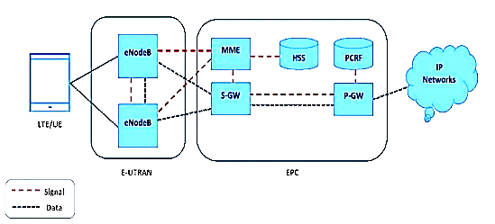
Methodology

Slide 12
Methodology
To carry-out dynamic spectrum refarming of 5G
We carried out dynamic spectrum refarming using the harmony-in-gradation method
Define User Classes:
Identify the different user classes based on their QoS requirements (e.g., latency, throughput, reliability).
Assign numerical identifiers to each user class.
Network Configuration:
Define the network parameters, such as the number of base stations, available bandwidth, frequency bands, power levels.
User Association:
Determine user-to-base-station associations based on location and signal strength.
Measure the received signal strength and select the optimal base station for each user.

Slide 13
Methodology
Resource Mapping:
Map the available resources to the user classes based on their QoS requirements.
Determine how much bandwidth, frequency, power, or time slots should be allocated to each user class to meet their specific QoS requirements.
Dynamic Resource Allocation:
Implement algorithms that continuously monitor network conditions, user demands, and QoS requirements.
Dynamically allocate and reallocate network resources to different user classes as needed.
Ensure efficient utilization of resources while maintaining fairness in resource allocation.
Performance Evaluation:
Implement mechanisms to evaluate the performance of the HiG method.
Measure key performance metrics such as throughput, latency.

Slide 14
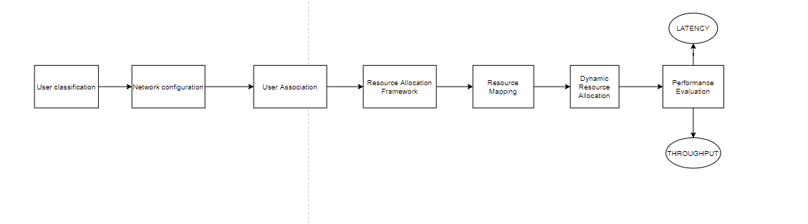
To evaluate the impact of dynamic spectrum refarming on the throughput and latency in 5G

Slide 15
Latency and Throughput
Network latency.
This is the measure of the time it takes for a packet of data to travel from the source to the destination.
Both the 5G and 4G technology have varying latency needs according to different applications
Network through-put.
Amount of data that can be transmitted over a network within a time period
Throughput can go up to the maximum bandwidth of a network, assuming ideal conditions, but this ideal value decreases when it comes to actual implementation

Slide 16
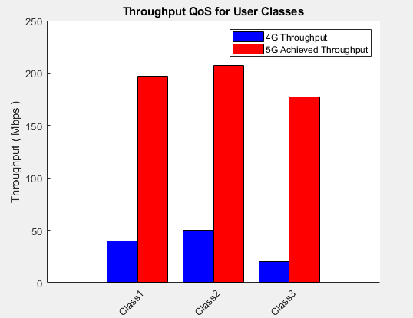
Results and Discussions

Slide 17
Results and Discussions
The graph consists of two sets of bars for each user class: achieved QoS and new achieved QoS.
4G Throughput:
The blue bars represent the achieved QoS values for throughput in the 4G network.
The height of each blue bar corresponds to the 4G achieved throughput value for the respective user class.
5G Achieved Throughput:
The red bars represent the new achieved QoS values for throughput in the 5G network.
The height of each red bar represents the 5G achieved throughput value for the respective user class.
By comparing the blue and red bars, you can observe the improvement in throughput for each user class when transitioning from the 4G network to the 5G network. There is an improvement in the throughput because of the dynamic increase in the bandwidth allocated to different user classes

Slide 18
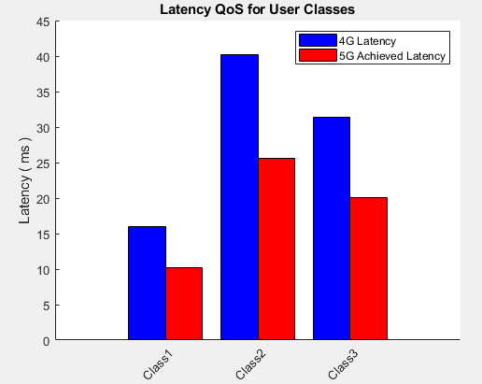
Results and Discussions

Slide 19
Results and Discussions
The graph consists of two sets of bars for each user class: achieved QoS and new achieved QoS.
4G Latency:
The blue bars represent the achieved QoS values for latency in the 4G network.
The height of each blue bar corresponds to the achieved latency value for the respective user class.
5G Achieved Latency:
The red bars represent the new achieved QoS values for latency in the 5G network.
The height of each red bar represents the new achieved latency value for the respective user class.
By comparing the blue and red bars, you can observe the improvement in latency for each user class when transitioning from the 4G network to the 5G network.
There is a reduction in latency in 5G because we are dynamically increasing bandwidth given to different users, this helps to accommodate their traffic demands and prevent congestion that could increase the latency
Increase available bandwidth to accommodate traffic demands and prevent congestion that can lead to latency.

Slide 20
Conclusion & Recommendation
Dynamic Spectrum Refarming has a positive impact to the 5G technology according to the results. It should be noted that there is a significant increase in the throughput(Up to 250Mbps) and decrease in the latency(Up to 10ms) of the network implementing dynamic spectrum sharing, which are key requirements for use cases of 5G applications.
Hence I go on to recommend Dynamic Spectrum refarming as a cheap and a quick way of setting up new 5G networks but at the same time, one should consider implementing 5G standalone for acquiring full benefits of 5G

Slide 21
References
[1]. Chen, T., Ma, H., & Zhang, Y. (2020). Dynamic Spectrum Refarming: A New Opportunity for Spectrum Sharing between 5G and 2G/3G Networks. IEEE Wireless Communications, 27(2), 6-12.
[2]. Zhang, Y., Li, Z., Ma, H., & Li, Z. (2019). Coexistence of 5G and 2G/3G systems with dynamic spectrum refarming: A Stackelberg game. IEEE Transactions on Wireless Communications, 18(7), 3661-3675.
[3]. Wang, W., Zhang, J., Zhang, R., & Qian, Y. (2021). Impact of Spectrum Refarming on Coexistence of 5G and 2G/3G Networks. IEEE Wireless Communications Letters, 10(1), 169-173.
[4]. Li, Z., Li, Y., Li, Z., Ma, H., & Zhang, Y. (2019). Dynamic Spectrum Refarming for 5G: From Research to Standardization. IEEE Communications Magazine, 57(12), 45-51.
[5]. Alshammari, R. A., & Alsaiari, M. (2020). Impact of 5G network deployment on 2G and 3G networks in Saudi Arabia: A comparative study. IEEE Access, 8, 139361-139369.

